Slide 1
5.4 Deleting a Module
To delete a specific module of a page, click on the Delete inside the Content module menu.
Use this facility with outmost care since modules will be permanently removed once deleted.

Slide 2
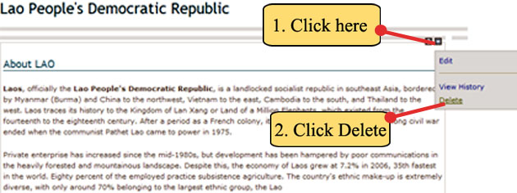
5.4 Deleting a Module
Example. To delete a module from the Lao People’s Democratic Republic page.
Step 1. Click the icon then click Delete.

Slide 3
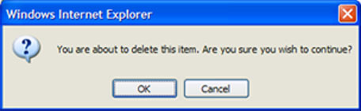
5.4 Deleting a Module
Step 2. Next the confirmation window will appear to delete the module. Click OK button if sure to be deleted.
CLICK HERE

Slide 4
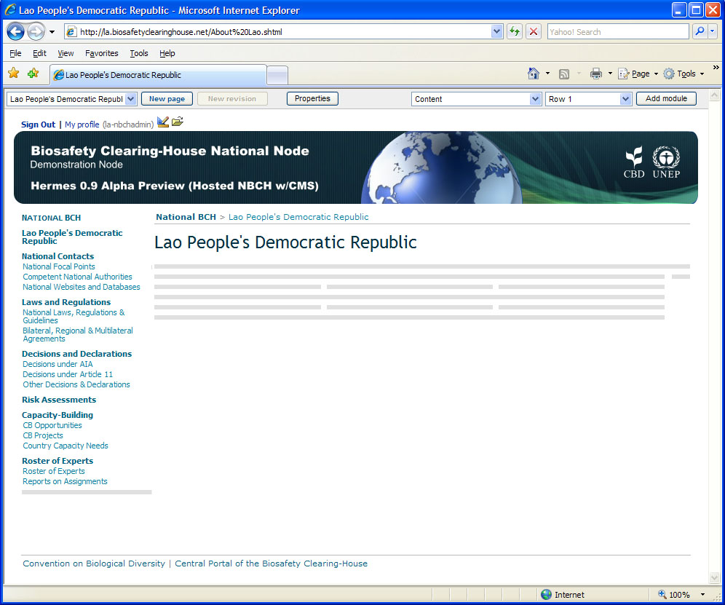
5.4 Deleting a Module
After deletion, the Lao People’s Democratic Republic page will be empty as shown.

Slide 5
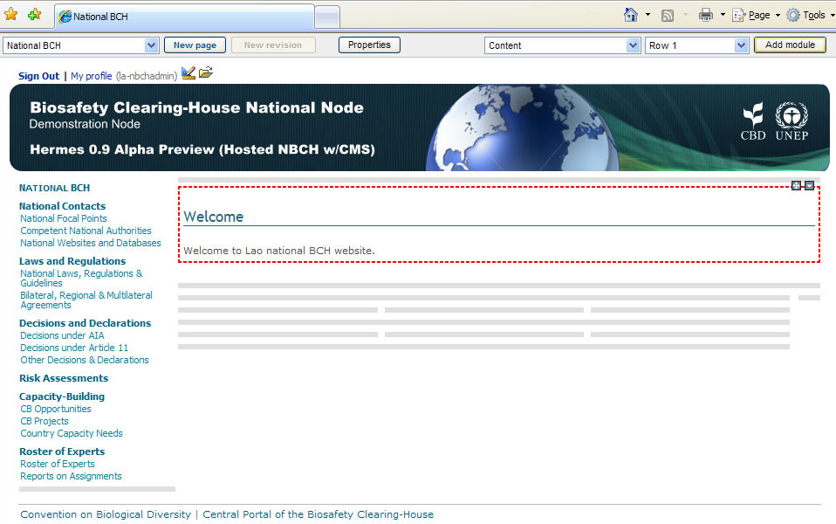
More Examples on Adding Modules
Example. Adding information to the NBCH index page. Set the page in design mode to do this example. Shown is the initial content of the index page.

Slide 6
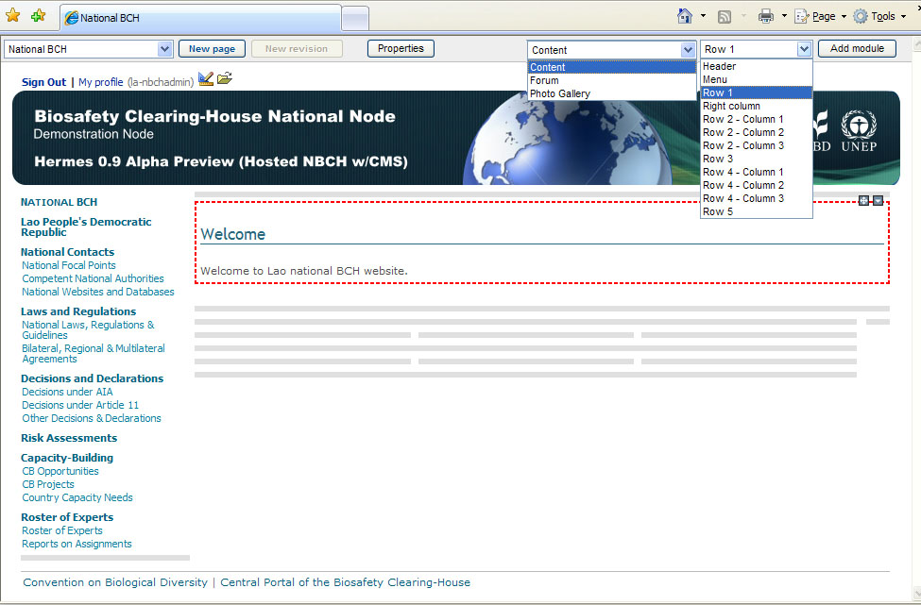
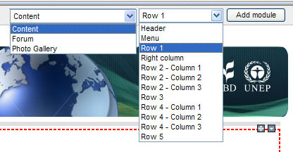
More Examples on Adding Modules
Step 1. Select Content and Row 1, then click Add module.
CLICK HERE

